Slide 1
CHAPTER: 1 Economics, Economy and its Central Problems
Class – 11
5/23/2020

Slide 2
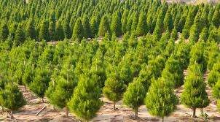
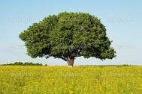
Types of Economy
Micro
Macro

Slide 3
Basis | Microeconomics | Macroeconomics
Meaning | Microeconomics deals with the behaviour of individual economic units. | Macroeconomics is the study of the economy as a whole.
Tools | Demand and Supply | Aggregate Demand and Aggregate Supply
Objective | To determine the price of a commodity or factors of production. | To determine the income and employment level of the economy.
 | It is also known as ‘Price theory’. | It is also known as ‘Income and Employment Theory’
Example | Individual income, individual output. | National Income, national output.
Aggregation | It involves limited degree of aggregation. | It involves the highest degree of aggregation.

Slide 4
DISTINGUISH BETWEEN
Positive Economics
Normative Economics
It deals with the things
“ as they are”
Based upon real facts
It can be verified with actual data
Pure and neutral between ends
It aims to make real
description of an economic activity.
It does not give any value judgments.
It deals with the things “as they should be”
Based upon opinions
It cannot be verified
Suggestive & optimum in nature
It aims to determine the ideals.
It gives value judgments.

Slide 5
CENTRAL PROBLEMS OF AN ECONOMY
Production, distribution and disposition of goods and services are the basic economic activities of life.
In the course of these activities, every society has to face scarcity of resources.
Because of this scarcity, every society has to decide how to allocate the scarce resources. It leads to following Central Problems of an Economy.

Slide 6
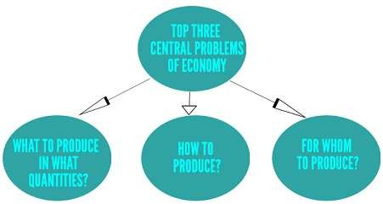

Slide 7
WHAT TO PRODUCE
This problem involves selection of goods and services to be produced and the quantity to be produced of each selected commodity
Guiding Principle: Allocate the resources in such a manner which gives maximum aggregate satisfaction.
So, every economy has this problem that what to produce and in what quantities. It has two dimensions.
(a) Kinds of goods to be produced
(b) Quantity of goods to be produced

Slide 8
HOW TO PRODUCE
This problem refers to the selection of technique to be used for the production of goods and services.
There are various techniques available to produce goods.
(a) Labour Intensive Technique (LIT) (greater use of labour)
(b) Capital Intensive Technique (CIT) (greater use of machines)
Choice of technique mainly depends upon the availability of resources, structure of economy and policies of the government. Thus it is difficult to allocate the resource efficiently and effectively.

Slide 9
FOR WHOM TO PRODUCE
Due to lack of resource in every economy, can’t satisfy all the wants of its people. So, there is a problem to select the category of people who consume the goods. Whether to produce goods for the rich section or poor section of society or more for rich and less for the poor section.
The allocation of scares resources and the distribution of the final goods and services are the central problem of the economy.
The Reason behind these central problems is the compulsion of making choices among alternative uses of scarce resources to get maximum satisfaction.
This problem refers to selection of category of people who will ultimately consume the goods, i.e. Whether to produce goods for more poor and less rich or more rich and less poor.
Guiding Principle: Ensure that urgent wants of each productive factor are fulfilled to the maximum possible event.

Slide 10
Questions :
Differentiate Micro Economy and Macro Economy?
Explain the problem of ‘How to Produce’ ?
Explain how scarcity and choice go together?
Define Positive Economy?
What do you mean by an Economy?

